Slide 1
Network and Cyber Security-I (CY2001) (Lecture 21 and 22)
Dr. Qaisar Shafi
Department of Computer Science,
National University of Computer & Emerging Sciences, Islamabad Campus

Slide 2
Network architecture of an organization with security challenges
Cloud basics with security challenges
IoT basics , applications with security challenges

Slide 3
“Network architecture of an organization with security challenges”
Complete diagram with challenges covered in class

Slide 4
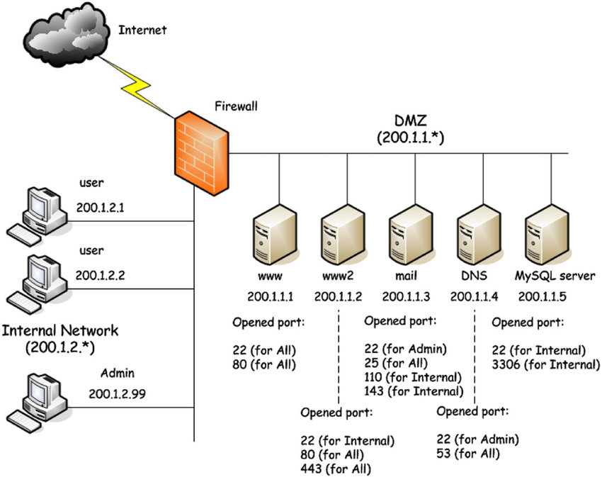
For reference

Slide 5
Security challenges
Covered on diagram in class

Slide 6
Cloud basics with security challenges
Complete diagram with challenges covered in class

Slide 7
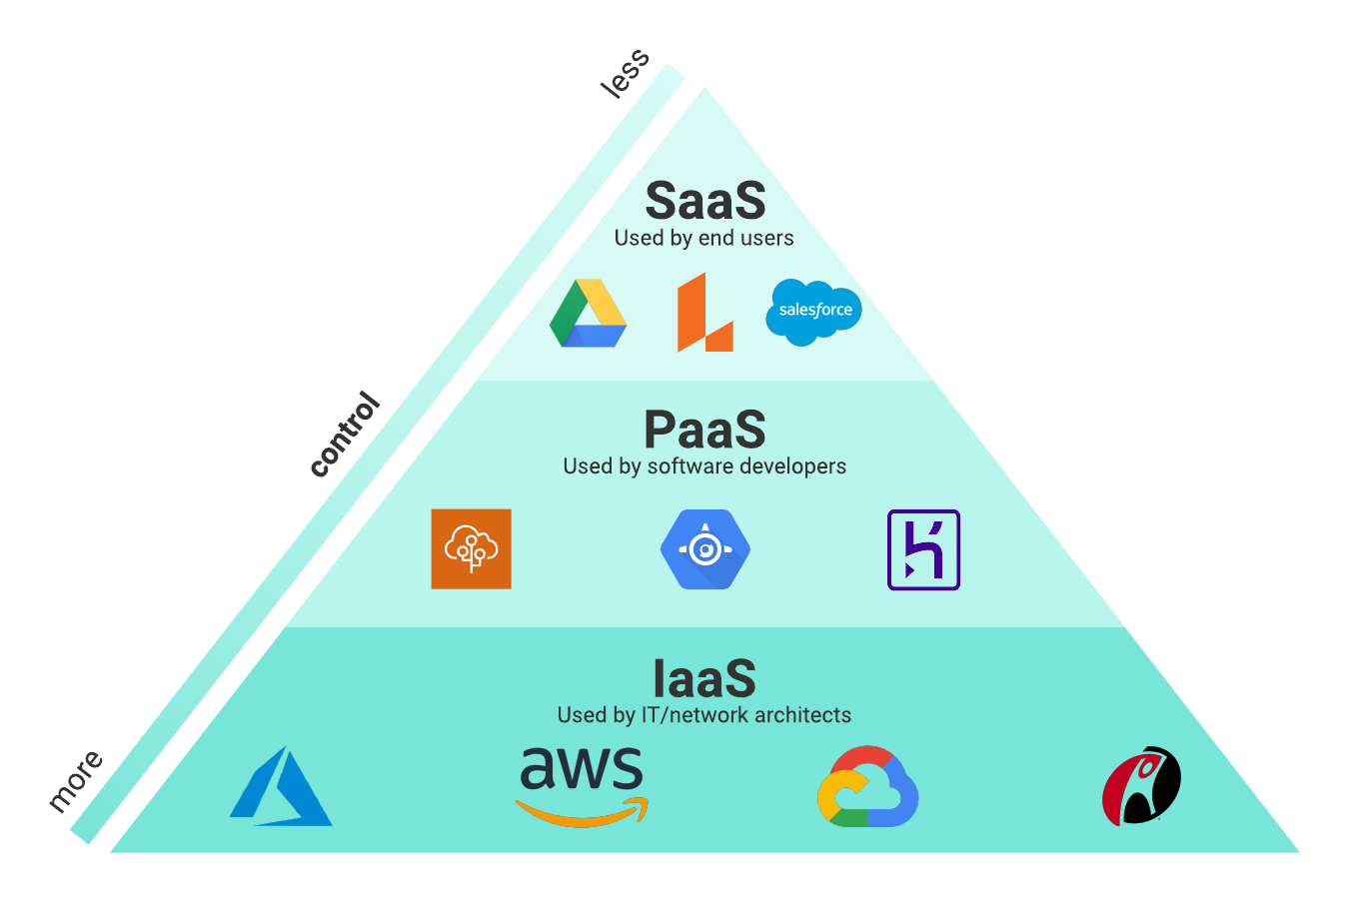
Cloud basics

Slide 8
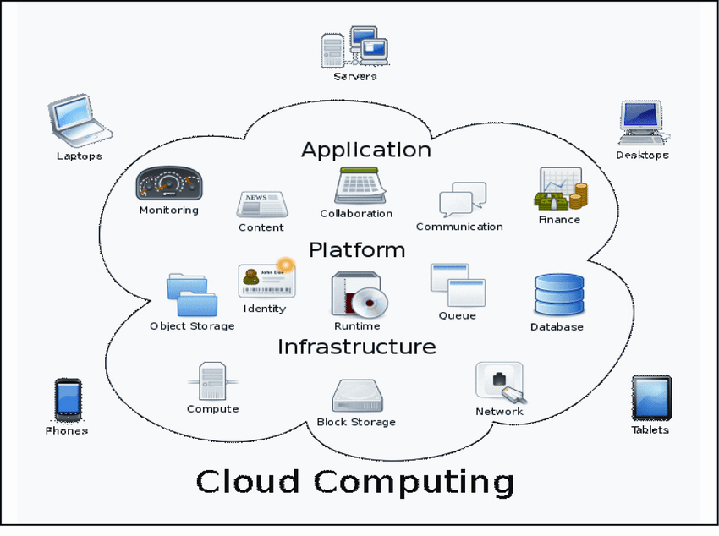
Cloud computing

Slide 9
Security challenges
Covered on diagram in class

Slide 10
IoT basics , applications with security challenges
Complete diagram with challenges covered in class

Slide 11
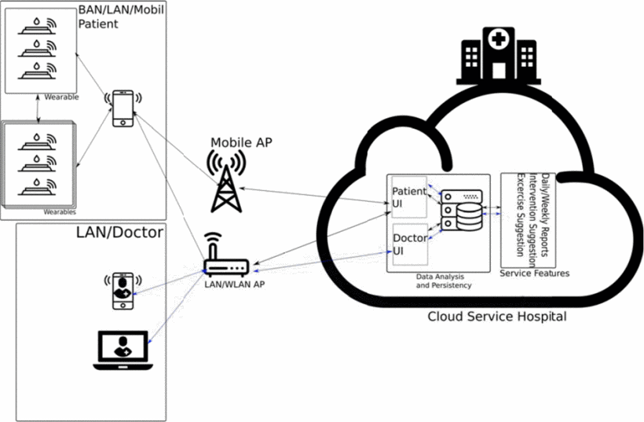
Typical IoT

Slide 12
Security challenges
Covered on diagram in class

Slide 13
Any Questions ?

